Slide 1
Introducing edhiphy.org: a new tool for the history of philosophy
Gregor Bös, Tilburg University
Deutscher Kongress für Philosophie Münster, 24.9.2024

Slide 2

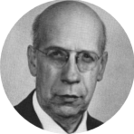
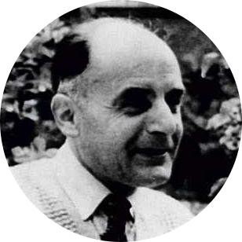
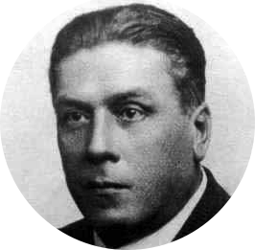
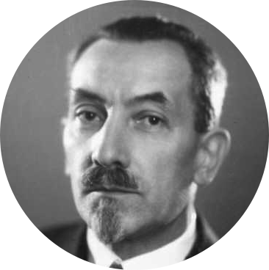

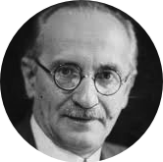
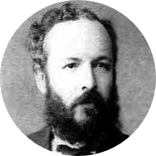
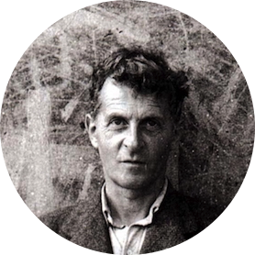
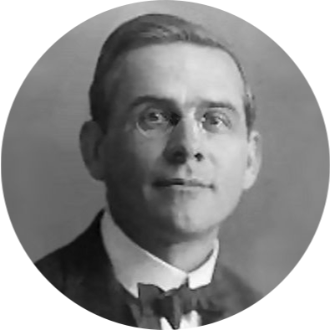
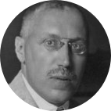
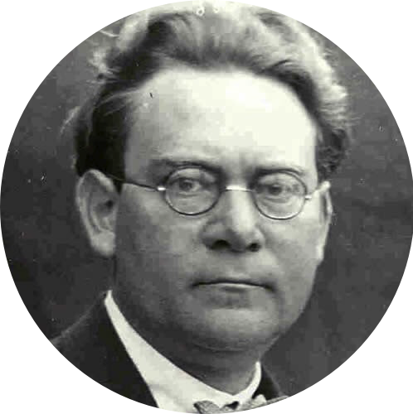
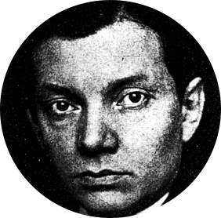
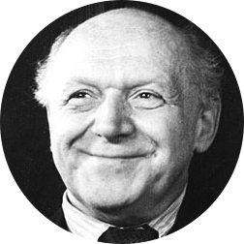
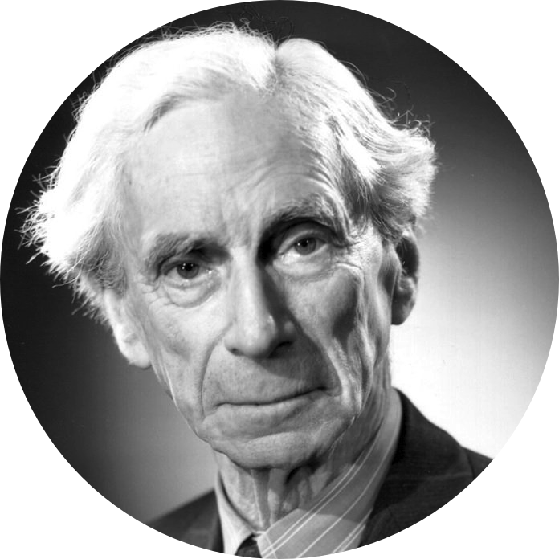
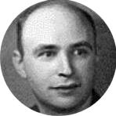
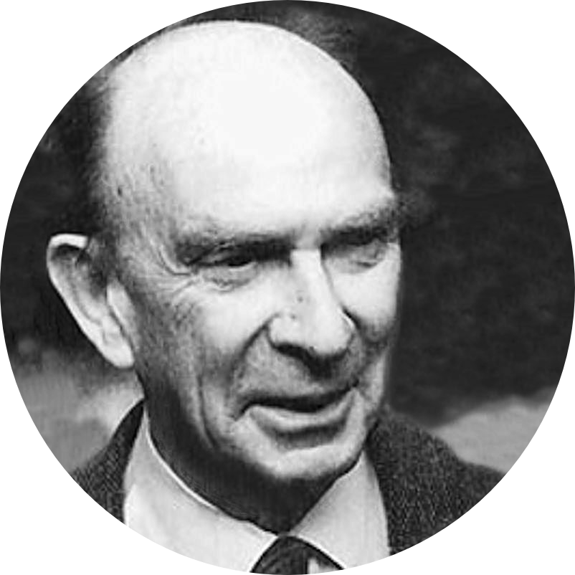
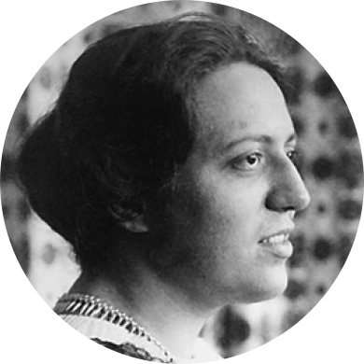
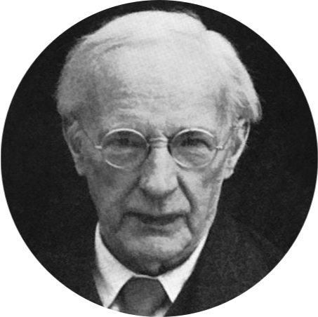
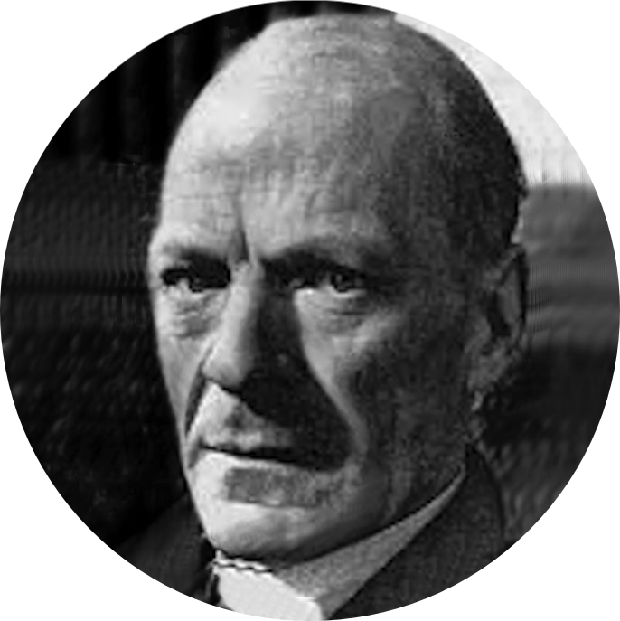
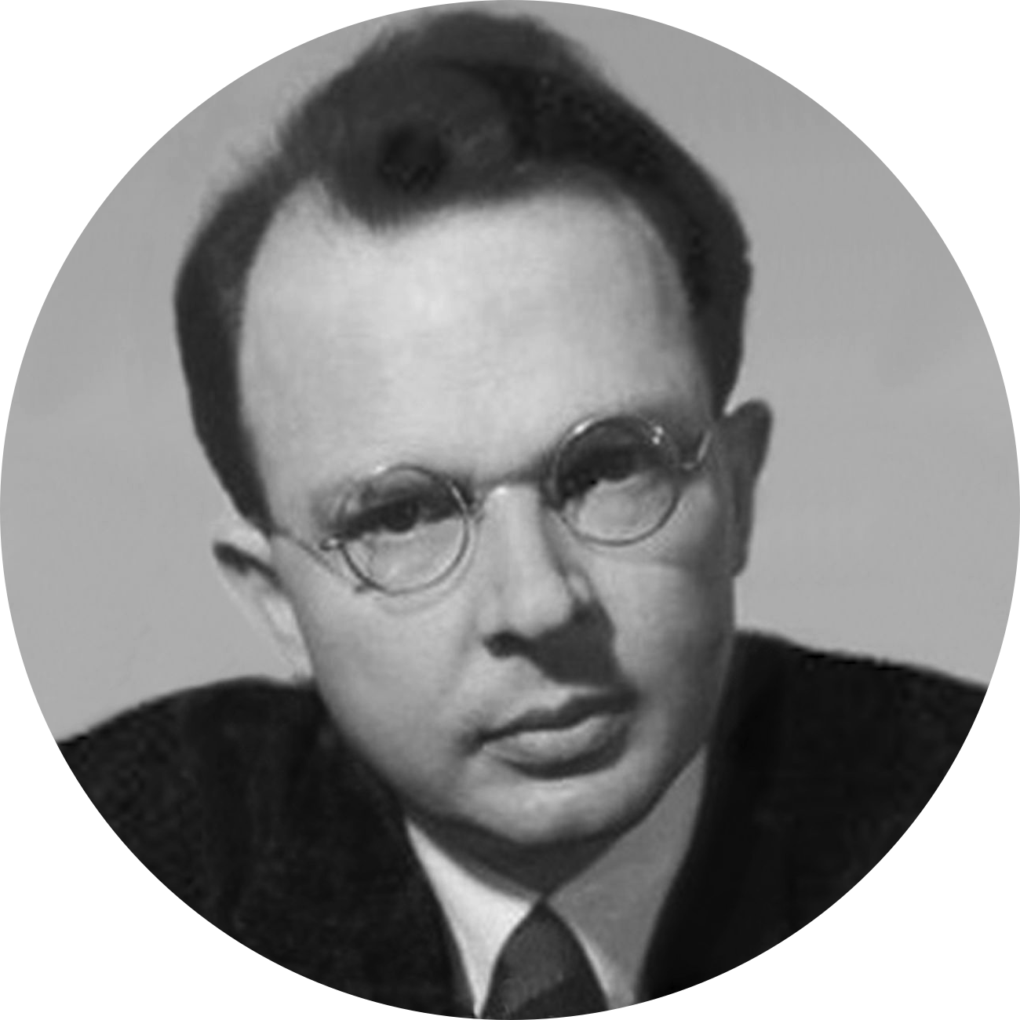

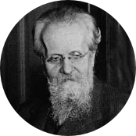
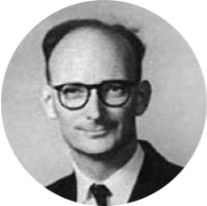
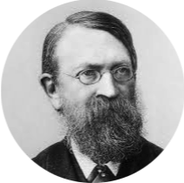
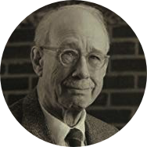
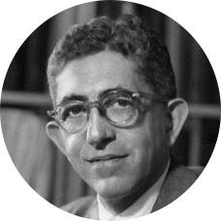
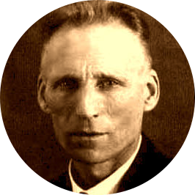
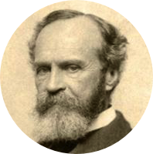
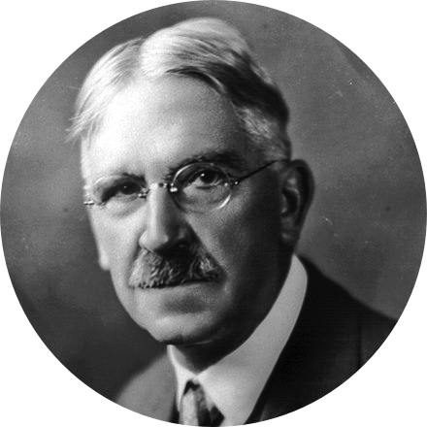
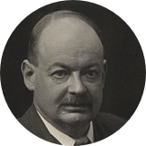
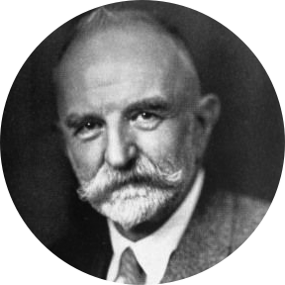
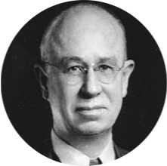
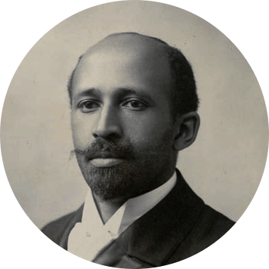
edhiphy.org
A new digital tool to study
philosophy and its history
Gregor Bös (Tilburg University)
Claudia Cristalli (Tilburg University)
Wessel Dankers (DRS, Tilburg University)
Fons Dewulf (HKUST/Tilburg University)
Ties van Gemert (Tilburg University)
Nina IJdens (Tilburg University)
Eugenio Petrovich (University of Turin)
Sander Verhaegh (Tilburg University)
Deutscher Kongress für Philosophie Münster, 24.9.2024

Slide 3
Joint Work
Database design: Eugenio Petrovich, University of Turin
Part of ERC & NWO project ‘Exiled Empiricists’: Sander Verhaegh (PI), Claudia Cristalli, Fons Dewulf (now HKUST), Ties van Germert, Nina IJdens, Tilburg University
Digital Research support: Wessel Dankers (Tilburg)

Slide 4
Outline
From Citations to Mentions
Constructing the edhiphy database
Application: the history of Logical Empiricism
edhiphy.org

Slide 5


Close reading, but not only close reading
Digital methods for (the history of) philosophy have a promise in at least two respects:
1. Close reading of historical sources has to be selective - how do we select?
2. How do we check the coarse-grained claims of historical narratives?

Slide 6
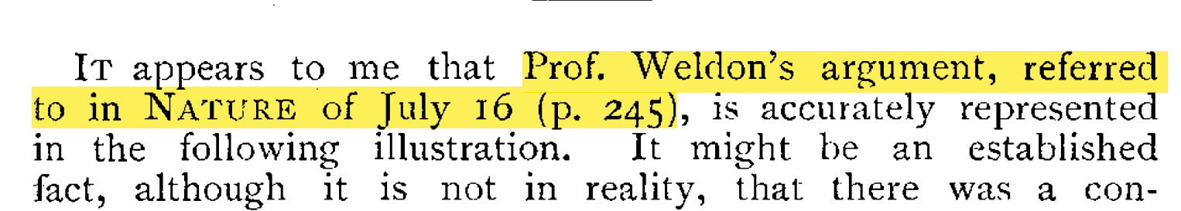
From Citations to Mentions
Citation analysis is a key method in quantitative studies of science
(in)famous citation metrics are e.g. the Impact Factor, h-index, etc. But citations have also been used to construct (co-)citation networks
Formalized citations became common in the early 20th century – but reference lists remain rare in philosophy until the 1980s
Cunningham, T. J. 1896 «The Utility of Specific Characters», Nature 54 (1396): 295 https://doi.org/10.1038/054295a0

Slide 7
From Citations to Mentions
But philosophers’ practice of referring to other scholars’ work is much older

Slide 8
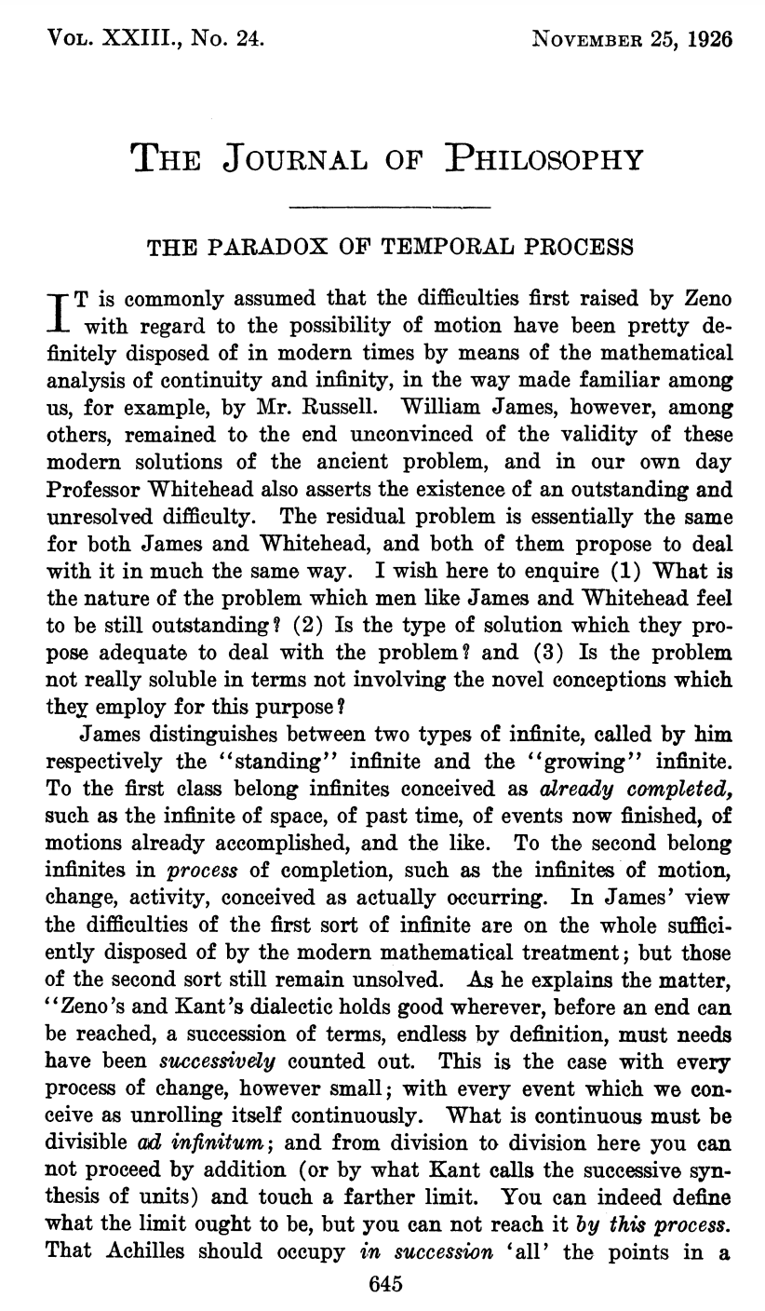
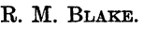

Slide 10
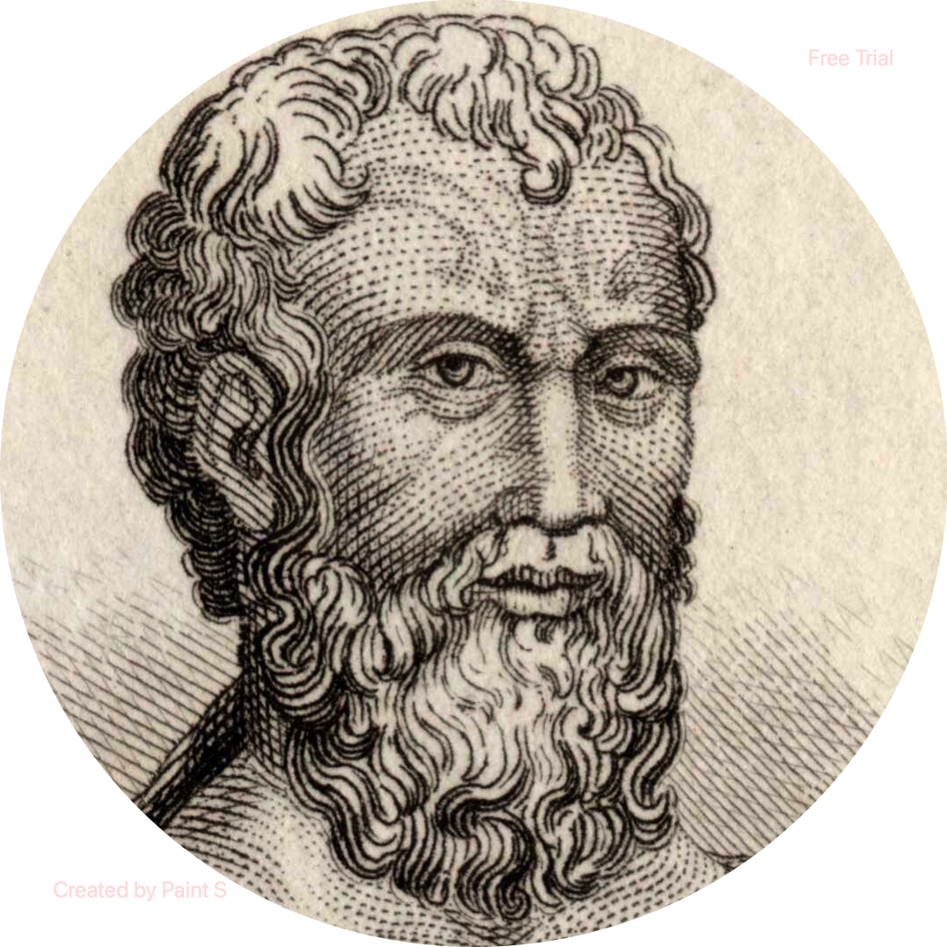

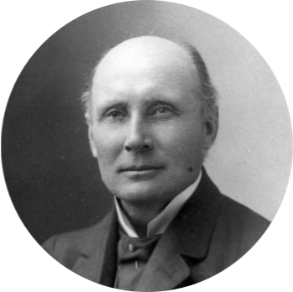
Zeno
William James
Immanuel Kant
Bertrand Russell
A. N. Whitehead
John Dewey

Slide 11
From Citations to Mentions
But philosophers’ practice of referring to other scholars’ work is much older
We define a ‘mention’ as a generalized form of reference to a philosopher: a link between a document and a scholar. In an explicit mention, this link is realized by the occurrence of a proper name

Slide 12
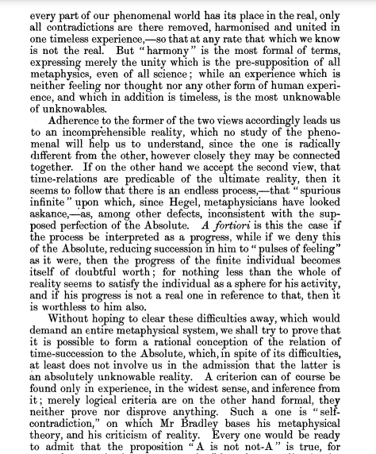
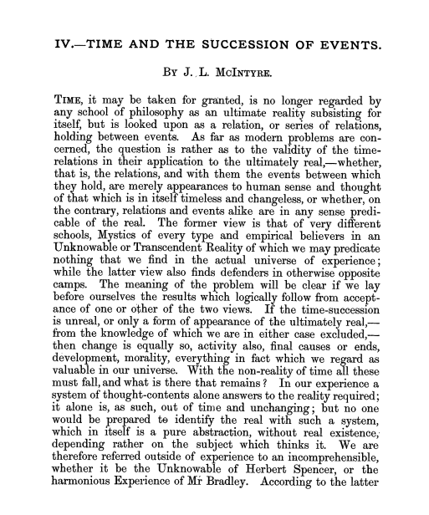
Constructing the edhiphy database
With the concept of a ‘mention’ we can construct a database to describe the structure of philosophy (similar to what the ‘Web of Science’ did with citations)
The Ingredients:
A corpus: 22,977 articles from 12 English-speaking journals* between 1890 and 1980
Metadata for 44,376 philosophers, including partial PhD and affiliation data
* Analysis, Mind, Phil. Studies, Philosophy, PPR, Phil. of Science, Proc. Arist. Soc., Synthese, J.Phil., Monist

Slide 13
Constructing the edhiphy database
Of course it is not that simple:
Non-trivial cleaning (e.g. journal headers)
But the main obstacle is the disambiguation of homonymous author names

Slide 14

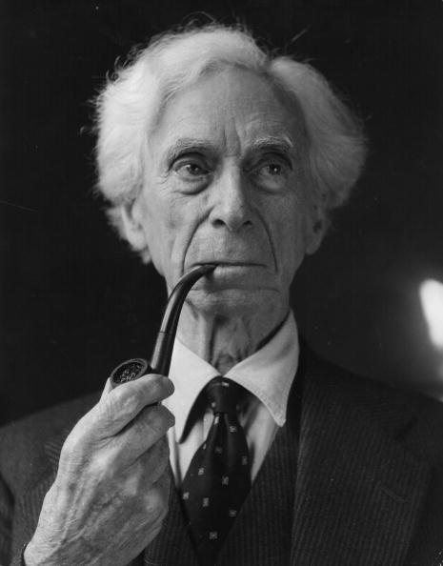
Constructing the edhiphy database
Bertrand Russell
Walter C. Russell
?
?
?
?
?
Bertrand Russell | P:664
Leonard J. Russell
Francis C. Russell
Russell B. Goodman
+450.000 mentions in EDHIPHY are homonymous!

Slide 15
Constructing the edhiphy database
Multiple Disambiguation Strategies are used successively:
Article-level
Oeuvre-level
Mention-based
Co-mention-based

Slide 16

Constructing the edhiphy database
We currently estimate the accuracy of the extracted mentions to be 82%-91%
More in:
https://doi.org/10.1007/s11192-024-05116-x

Slide 17
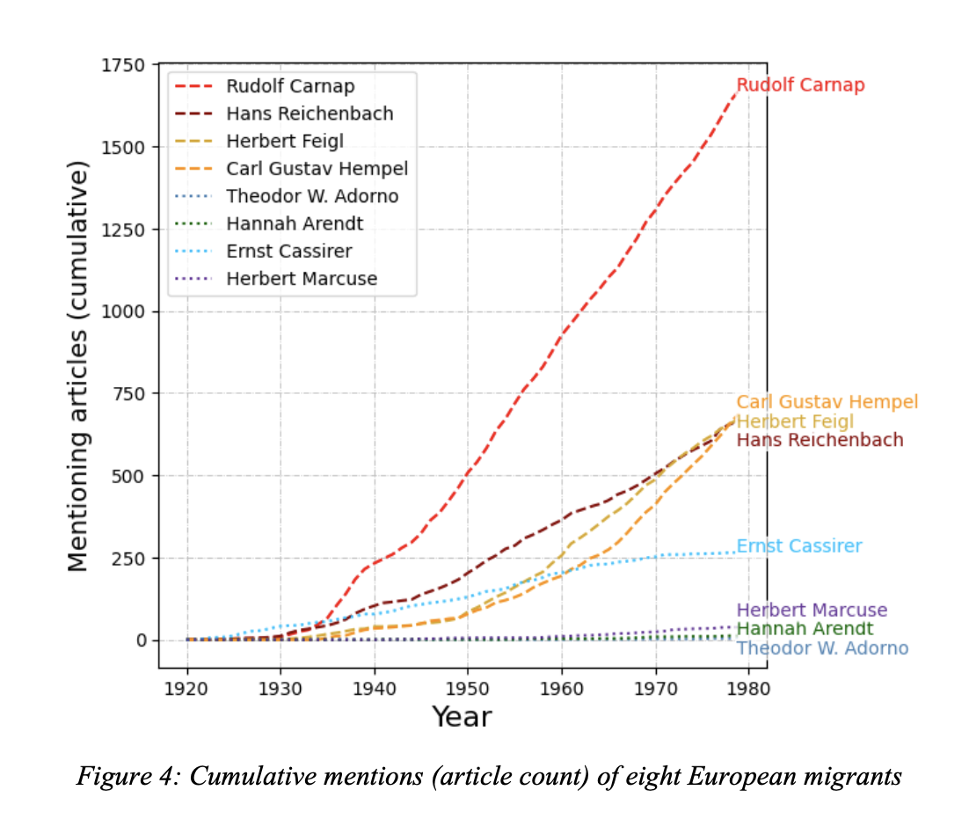
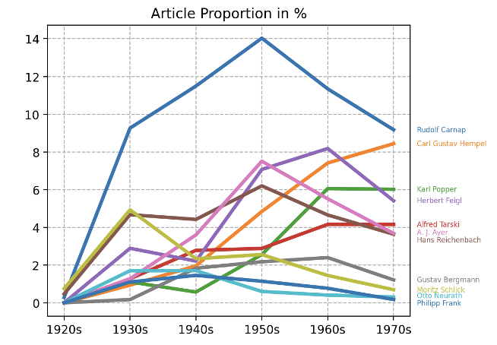
Application: the history of Logical Empiricism
See Verhaegh, S., Petrovich, E. and Bös, G.E. (forthcoming) ‘The American Reception of Logical Empiricism: A Mention-Based Bibliometric Analysis’, in F. Stadler and G. Schiemer (eds) The Vienna Circle - History and Legacy. Springer (Vienna Circle Institute Yearbook). Preprint available on https://edhiphy.org/publications
Mention statistics of eleven logical empiricists in philosophy journals by decade.

Slide 18
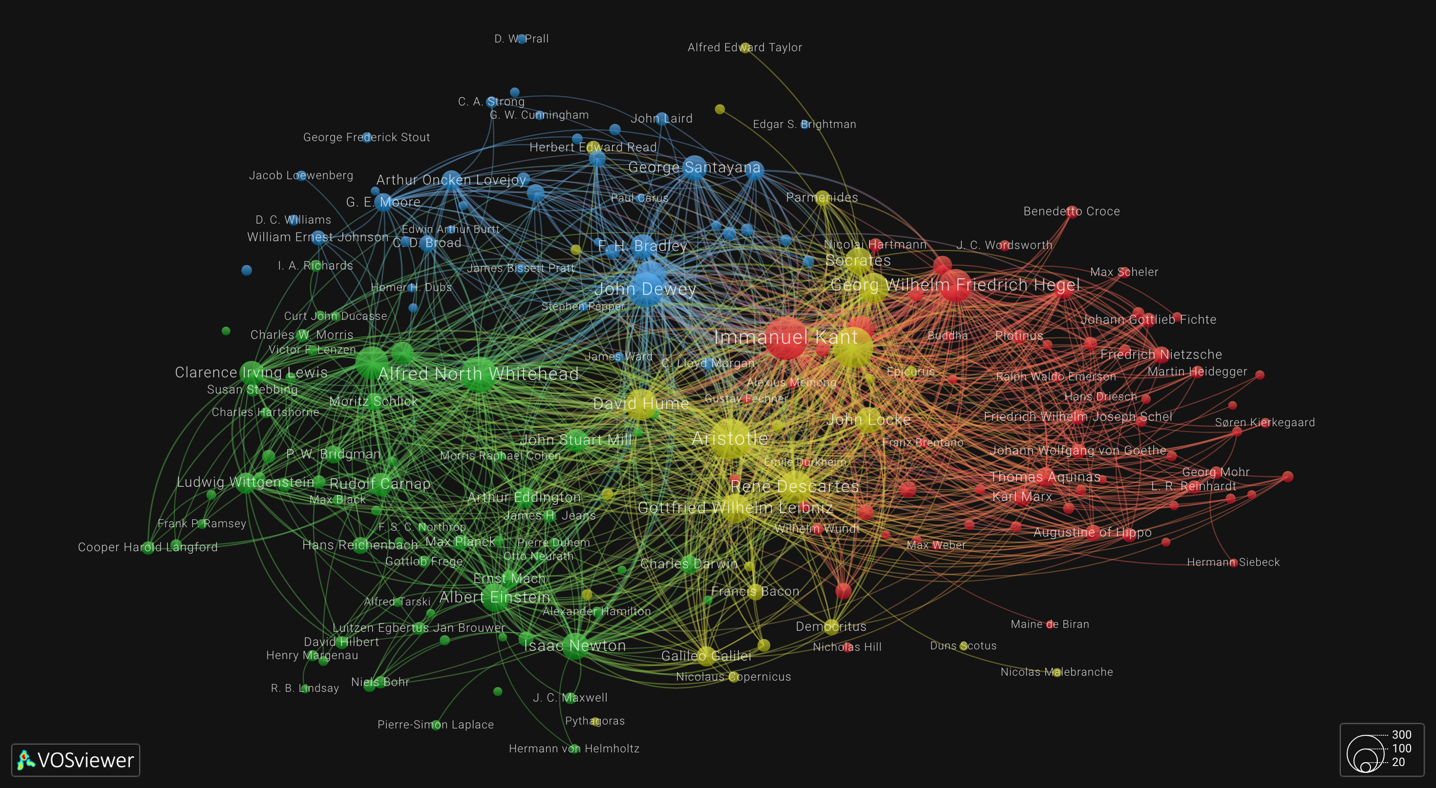
Philosopher co-occurrences in American Philosophy 1931-1940 Logical Empiricists are clustered with British Analytic Philosophers

Slide 19
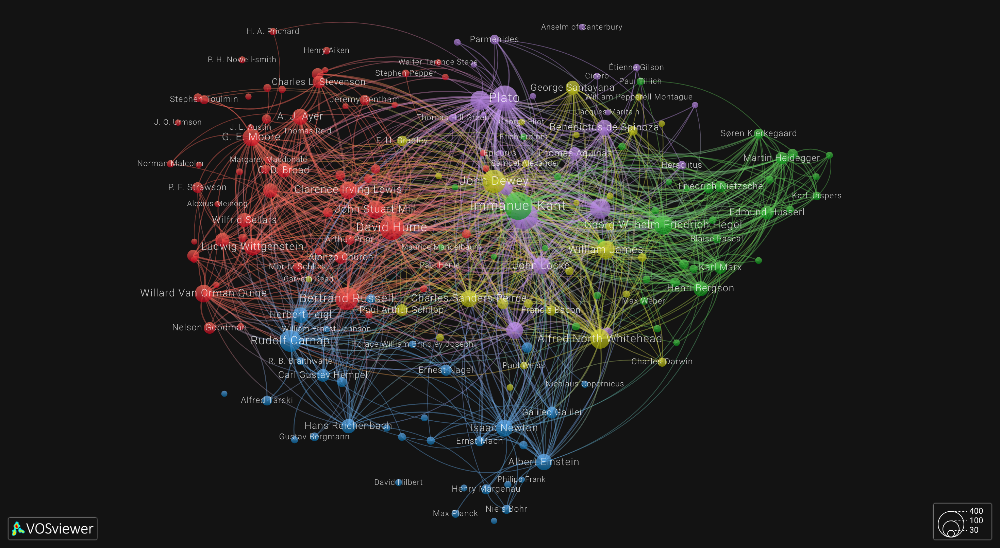
Philosopher co-occurrences in American Philosophy 1951-1960.
Logical Empiricists are clustered with Scientists

Slide 20
edhiphy.org
The edhiphy database is now available as a a web-application. This allows you to:
Inspect individual philosophers
Study aggregate mentions over periods
Inspect the co-mention links between philosophers
Search the extracted mentions
Create custom network plots
Submit custom SQLite queries
https://edhiphy.org

